Slide 1
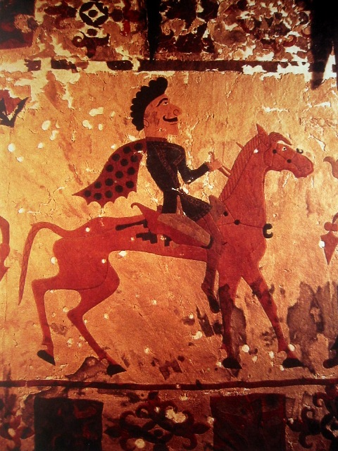


Slide 2
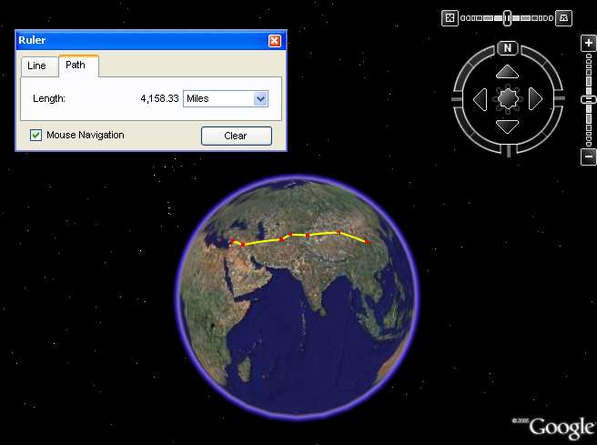
Viewing the Silk Road from Space

Slide 3
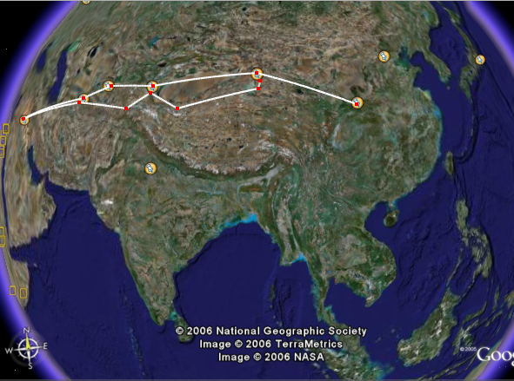
Beijing
Dunhuang
Samarkan
Ksahgar
Antioch
Merv
X’ian

Slide 4
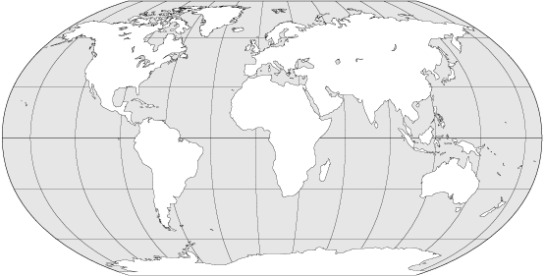












Common “Silk Road” Routes

Slide 5
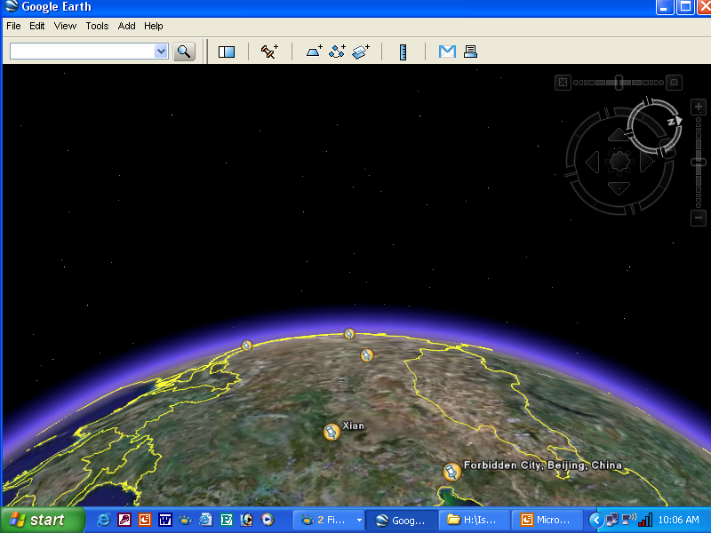
The Road Ahead: Begin Your Journey in China
West
East

Slide 6
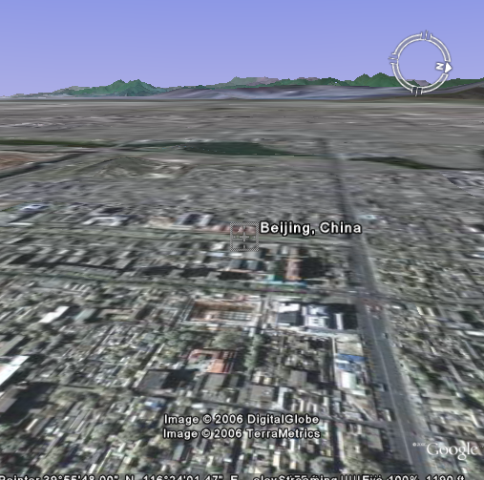
Heading West from Beijing

Slide 7
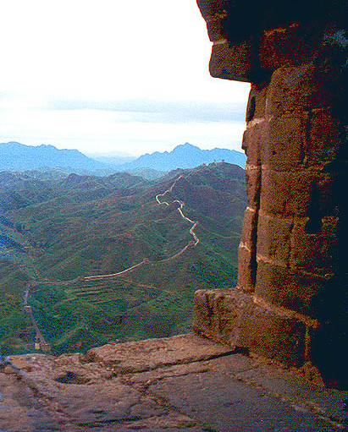
Heading West from Beijing

Slide 8
Next Stop…X’ian
Beijing
X’ian

Slide 9
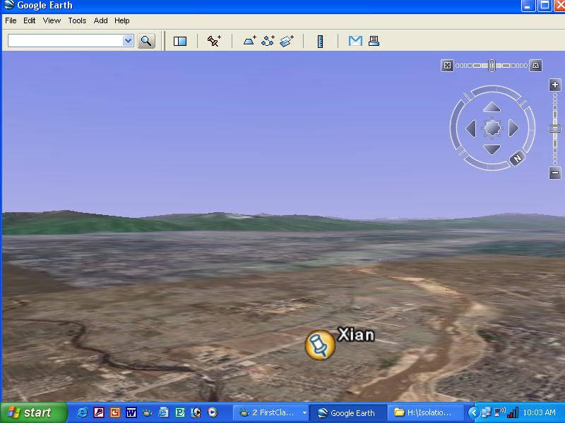
Looking West from X’ian

Slide 10

Looking West from X’ian

Slide 11
Next Stop…Dunhuang
Beijing
Dunhuang
X’ian

Slide 12
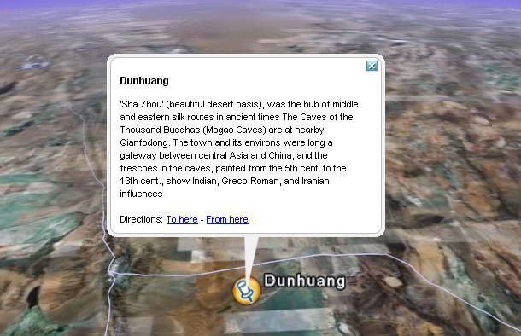

Slide 13
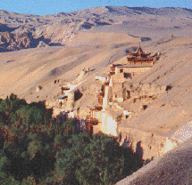
Mogao Caves Near Dunhuang

Slide 14
Keep Moving West to Kashgar
Beijing
Kashgar
Dunhuang
X’ian

Slide 15
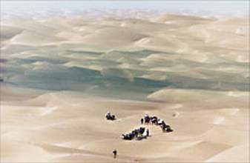
Dunhuang to Kashgar: Go Around the
Takla Makan Desert

Slide 16
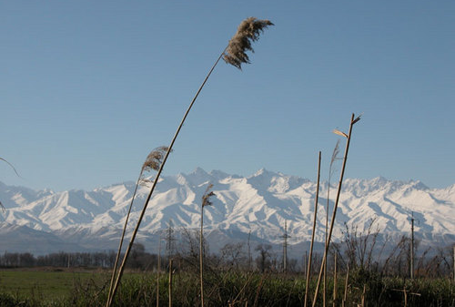
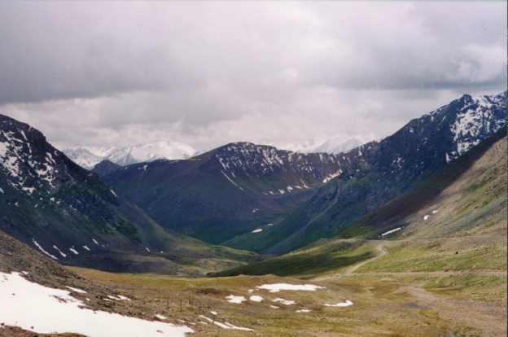
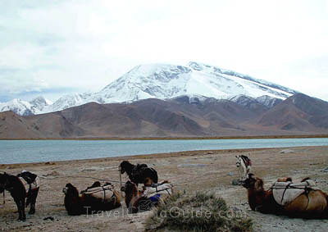
…and Cross the Tien Shan Mountain Range

Slide 17
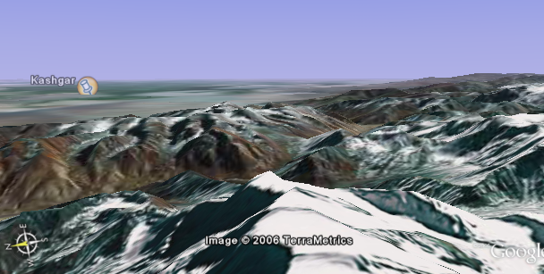
Arriving at Kashgar

Slide 18
Now…On to Merv
Beijing
Kashgar
Dunhuang
Merv
X’ian

Slide 19
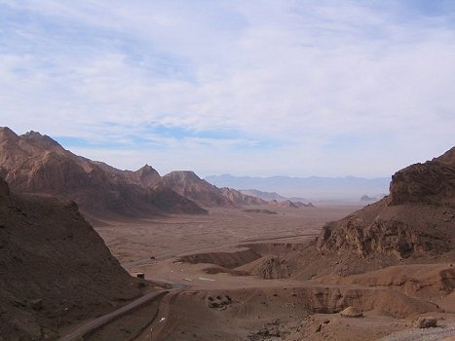
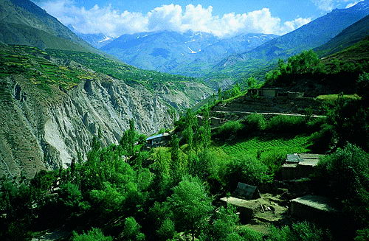
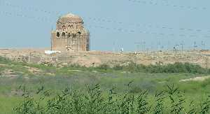
Kashgar to Merv: More Deserts and Mountains
Bactrian Desert
Pamirs
Ancient Merv

Slide 20
Your Journey So Far:
You have traveled over 3,000 difficult miles
You have crossed the Takla Makan Desert, the Tien Shan Mountain Range, passed through territories of hostile warriors, crossed the Pamir Mountains and the Bactrian Desert.
Only 1,532 miles to go!!!

Slide 21
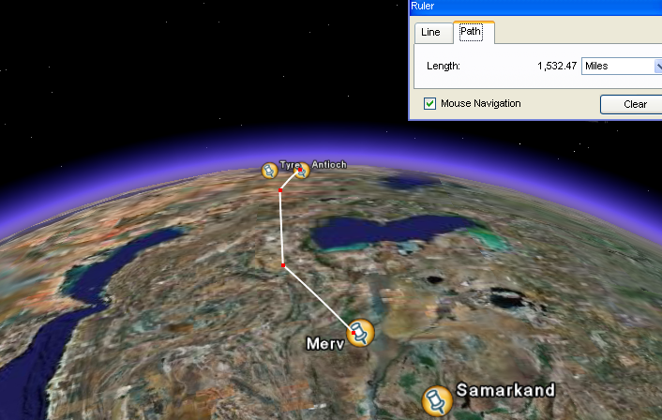
The Road Ahead…

Slide 22
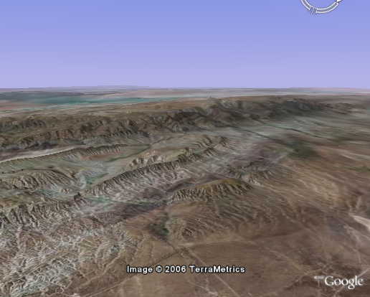
Plains and Mountain Ridges

Slide 23
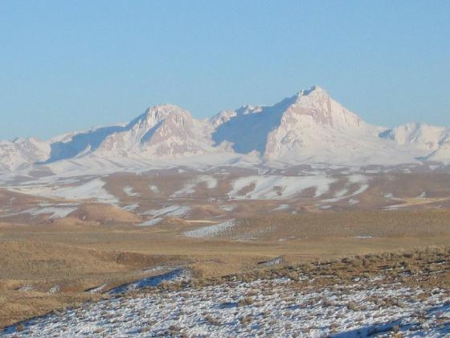
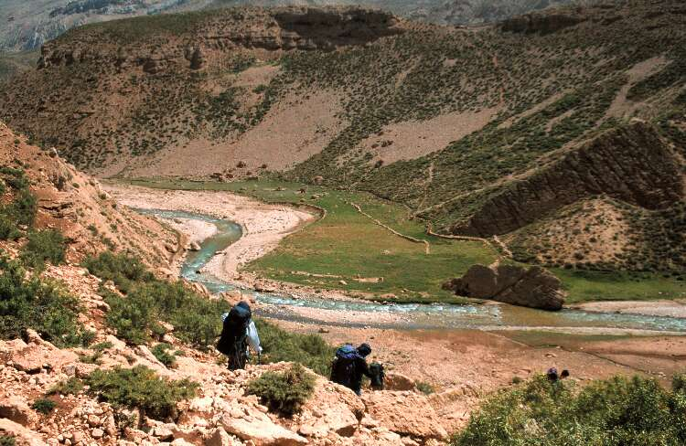
Zagros Mountains

Slide 24
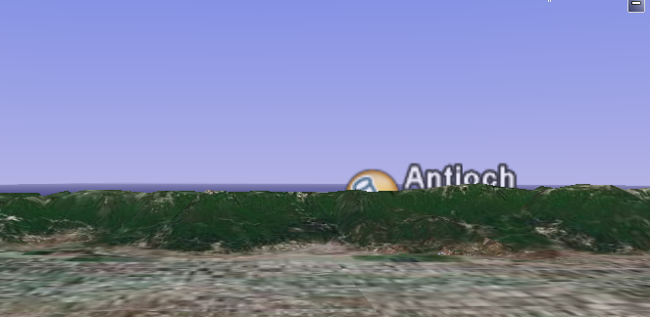
Your Final Hurdle to Antioch… the Sultan Mountain Range

Slide 25
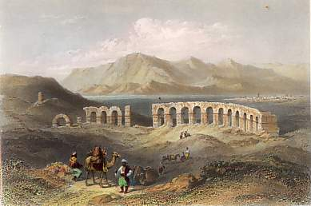
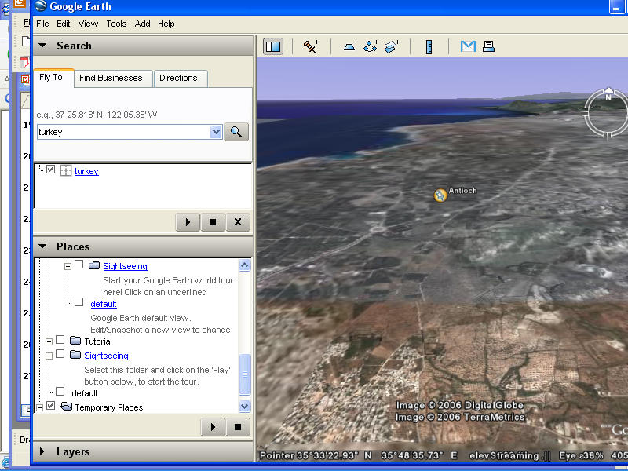
Finally…Antioch

